Slide 1


Unit testing with JUnit
Elena Grumazescu

Slide 2


Who am I and how did I get here?
Short answer:

Slide 3
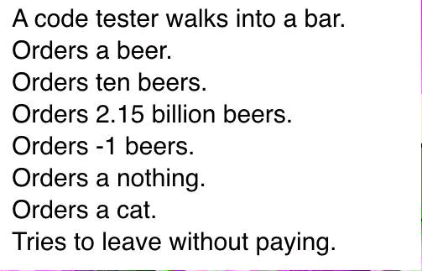
Types of testing
Unit testing – test the smallest parts of a code (classes or methods)
Integration testing – test multiple components which are combined or integrated – checks regression
System testing – test the whole sistem and check if it works as it was designed
Acceptance testing – testing performed by the client, to check that the application behaves how it was designed

Slide 4
Why unit testing?
The goal is to write tests that fail, so you can correct the errors on time
Improves the implementation via new insights
Anticipates errors - testing motivates developers to think about ways to break their code, thereby leading to more resilient applications.
The tests and the code work together to achieve better code
Easy to write
Can be run automatically when nedded
Multiple frameworks and instruments exist on the market, which simplifies the way we write tests

Slide 5
JUnit concepts
JUnit – a simple framework to write repeatable tests
Concepts:
Fixture – set of objects used in a test
Test Case – class which defines the fixture for a number of tests
Setup – a method for the definition of fixture before testing
Teardown – a method for the destruction of fixture, after testing
Test Suite – a collection of Test Cases
Test Runner – instrument used for running test suites and displaying results

Slide 6
JUnit architecture
TestRunner executes tests and reports TestsResults
A test extends an abstract class called TestCase
To write tests you need to understand the Assert class
Each assert method has the following parameters: message, expected-value, actual-value - the message is optional, but it is BAD PRACTICE not to use it
Examples of asserts:
assertEquals(message, expected, actual)
assertFalse(message, condition)
assertTrue(message, condition)
assert(Not)Null(message, object)

Slide 7
The structure of a unit test
Prepair the initial conditions (create objects, initialize resources)
Call the methods that need to be tested
Verify methods by comparing the generated results with the expected ones
Release the used resources

Slide 8
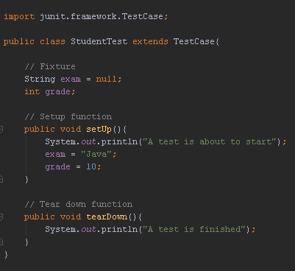
Examples
Defining a test class
import junit.framework.TestCase;
public class TestMath extends TestCase{}
The name is important and it must be TestMyClass or MyClassTest
A unit test must evaluate a single method
In a test, a single assert method should be found – a single aspect is tested
Unit tests mult be independent one from another

Slide 9
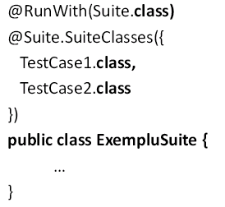
Test suites – JUnit4
Collection of tests evaluated together

Slide 10
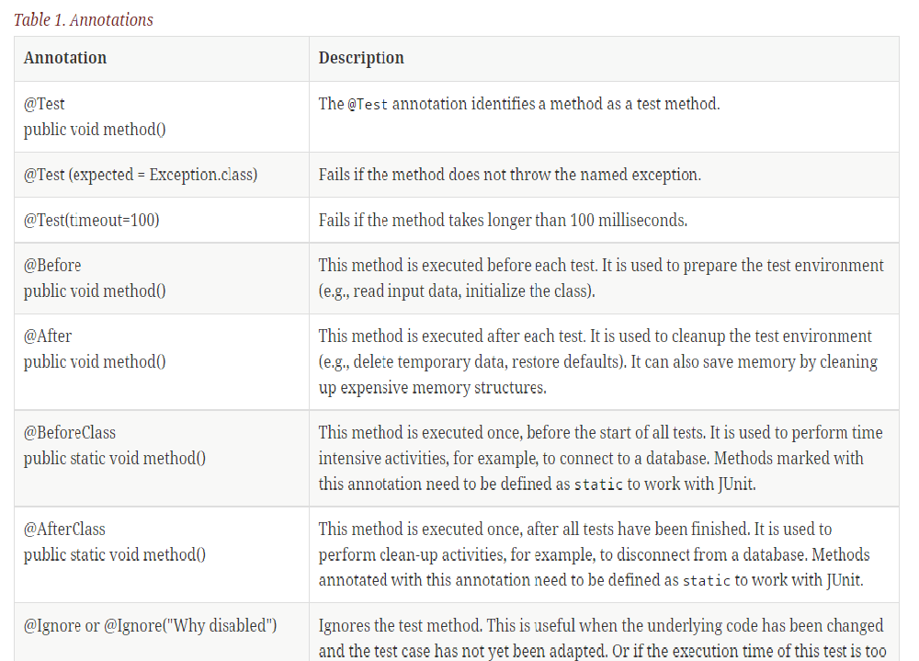
Annotations – JUnit4

Slide 11
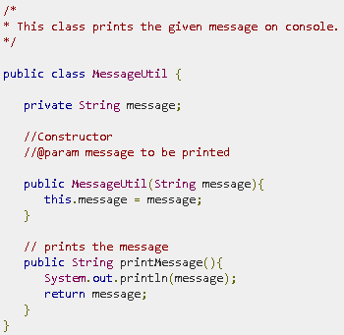
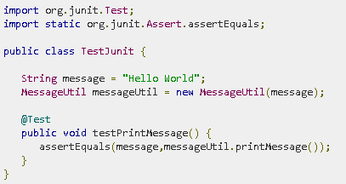
More examples

Slide 12
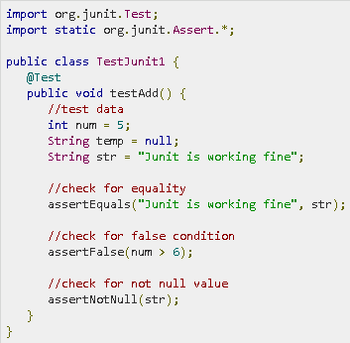
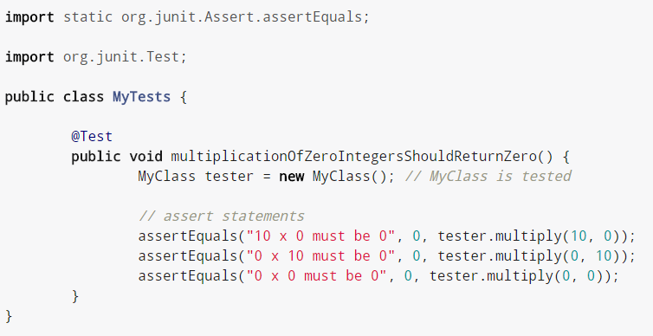

Slide 13
JUnit4 resources
https://www.tutorialspoint.com/junit/
http://www.vogella.com/tutorials/JUnit/article.html
http://junit.org/junit4

